Slide 1
Lighting and Shading
Course Code: CSC 3224
Course Title: Computer Graphics
Dept. of Computer Science
Faculty of Science and Technology
Lecturer No: | 13 | Week No: | 10 | Semester: | Fall 2021-2022
Lecturer: | MAHFUJUR RAHMAN, mahfuj@aiub.edu

Slide 2
Lecture Outline
Lighting
Types of Lighting Sources
Phong illumination model
Shading
Interpolation
Flat Shading
Smooth Shading
Lighting/Shading in OpenGL

Slide 3
Lighting
Definition
Ray tracing: ray tracing is a rendering technique for generating an image by tracing the path of light as pixels in an image plane and simulating the effects of its encounters with virtual objects. Follow light rays through a scene Accurate, but expensive.
Phong Illumination model (this lecture): Illumination model is used to calculate the intensity of the light that is reflected given point on surface Approximate only interaction light, surface, viewer Relatively fast , supported in OpenGL.

Slide 4
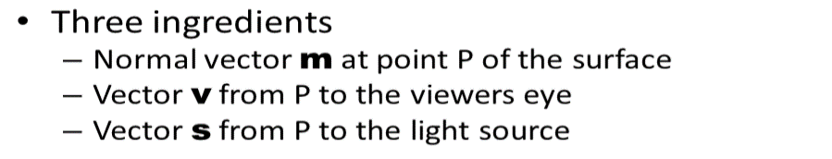
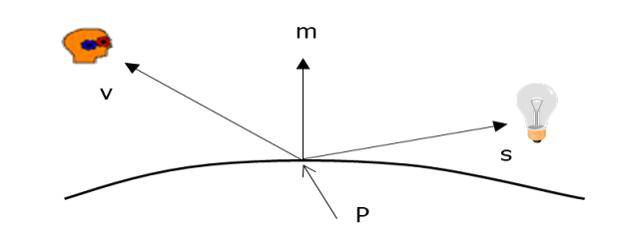
Lighting
Geometric Ingredients

Slide 5
Lighting
Types of Light Sources
Ambient light: no identifiable source or direction
Diffuse light - Point: given only by point
Diffuse light - Direction: given only by direction
Spot light: from source in direction

Slide 6
Lighting
Ambient Light
Global ambient light
Independent of light source
Lights entire scene
Local ambient light
Contributed by additional light sources
Can be different for each light and primary color
Computationally inexpensive

Slide 7
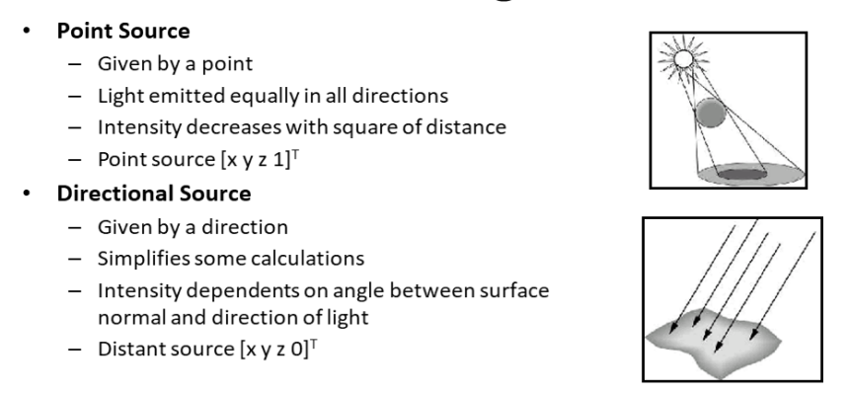
Lighting
Diffuse Light

Slide 8
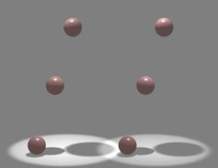
Lighting
Spot Light
Spotlights are point sources whose intensity falls off directionally.
- Requires color, point direction, fall off parameters

Slide 9
Lighting
Phong illumination model
Emission
Used to model objects that glow
Ambient Reflection
A simple way to model indirect reflection
Diffuse Reflection
The illumination produced by dull smooth surfaces
Specular Reflection
The bright spots appearing on smooth shiny surfaces

Slide 10
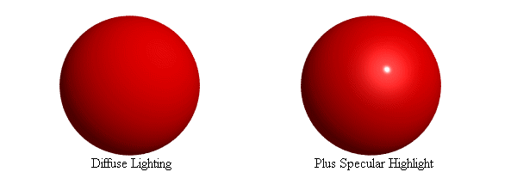
Lighting
Specular Reflection
Shiny surfaces exhibit specular reflection
- Polished metal
- Glossy car finish
A light shining on a specular surface causes a bright spot known as a specular highlight
Where these highlights appear is a function of the viewer’s position, so specular reflectance is view dependent

Slide 11
Lighting
Diffuse Reflection
Ideal diffuse reflection
- An ideal diffuse reflector, at the microscopic level, is a very rough
surface (real-world example: chalk)
- Because of these microscopic variations, an incoming ray of light is
equally likely to be reflected in any direction over the hemisphere

Slide 12
Shading
Definition
Shading refers to the process of altering the color of an object/surface/polygon in the 3D scene..
It distance from lights, its angle to the camera and material properties to create a photorealistic effect.
Shading is performed during the rendering process by a program called a shader.

Slide 13
Shading
Illumination
Illumination, an observable property and effect of light, may also refer to Lighting, the use of light sources. Illumination (image), the use of light and shadow in art.
An illumination model, also called a lighting model and sometimes referred to as a shading model, is used to calculate the intensity of light that we should see at a given point on the surface of an object.

Slide 14
Shading
Intensity
Intensity is a measurable amount of brightness, color, lighting..
Example:
Illumination models is used to calculate the intensity of light that is reflected at a given point on a surface.
Rendering methods use the intensity calculations from the illumination model to determine the light intensity at all pixels in the image.

Slide 15
Shading
Interpolation
Interpolation is in-betweening, or filling in frames between the frames. It typically calculates the in between frames to draw images semi-automatically.
It defines the stating point and end point. It also defines the point between start and end point.

Slide 16
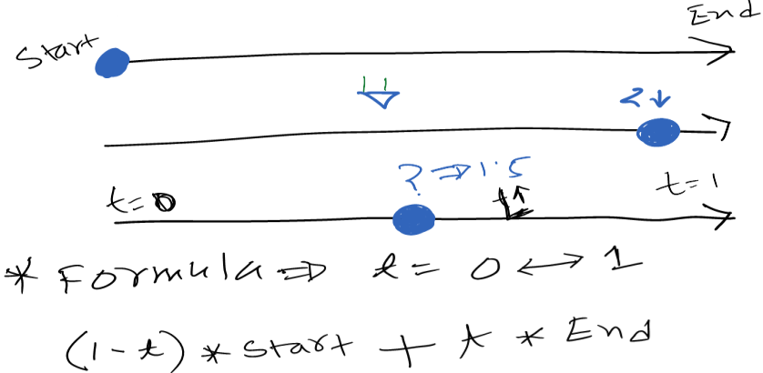
Shading
Interpolation

Slide 17
Shading
Vertex and Vertex Normal
Vertex
Vertex is a data structure that describes certain attributes, like the position of a point in 2D or 3D space, at multiple points on a surface.
Vertex Normal
A vertex normal at a vertex is a directional vector associated with a vertex.

Slide 18



Shading
Types of Shading
Flat Shading
Smooth Shading
Gouraud Shading
Phong Shading

Slide 19
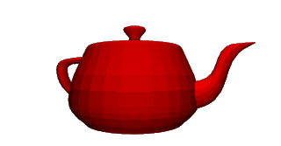
Shading
Flat Shading
For each polygon
Determines a single intensity value
Uses that value to shade the entire polygon
Assumptions
Light source at infinity
Viewer at infinity
The polygon represents the actual surface being modeled

Slide 20
Shading
How to do Flat shading
Find the intensity of the pixel. Then using the Intensity coloring the whole object

Slide 21
Shading
Drawback of Flat Shading
Find the intensity of the pixel. Then using the Intensity coloring the whole object

Slide 22
Shading
Drawback of Flat Shading
Find the intensity of the pixel. Then using the Intensity coloring the whole object

Slide 23
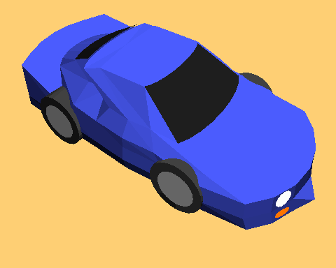
Shading
Example of Flat Shading

Slide 24
Shading
Smooth Shading
1. Determine average unit normal vector at each vertex of
the polygon
2. Apply an illumination model at each polygon vertex to
obtain the light intensity at the position
3. Linearly interpolate the vertex intensities over the
projected area of the polygon
Smooth Shading Two types
Gouraud Shading
Phong Shading (do not confuse with Phong Lighting Model)

Slide 25
Shading
How to do Gouraud Shading
Step 1: To obtain average unit normal Vector

Slide 26
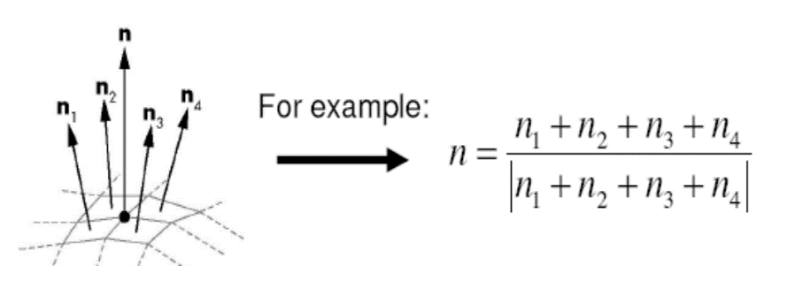
Shading
How to do Gouraud Shading
Step 1: To obtain average unit normal Vector

Slide 27
Shading
How to do Gouraud Shading
Step 2: Apply Illumination model for calculating
intensity for finding the vertex intensity.
Step 3: Intensity Interpolation (I)

Slide 28
Shading
How to do Gouraud Shading

Slide 29
Shading
Phong Shading
Instead of interpolating vertex intensities
Phong shading – interpolate vertex normal
This results in
More accurate calculation of intensity values
More realistic display of surface highlights
Greater reduction in the match band effect

Slide 30
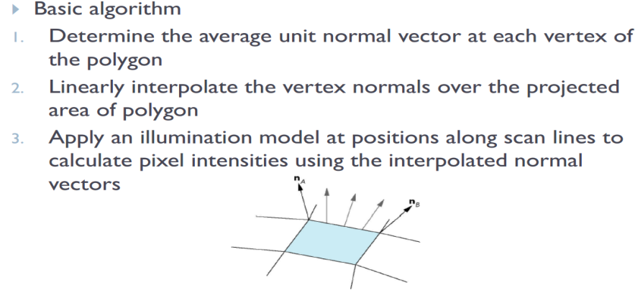
Shading
How to do Phong Shading

Slide 31
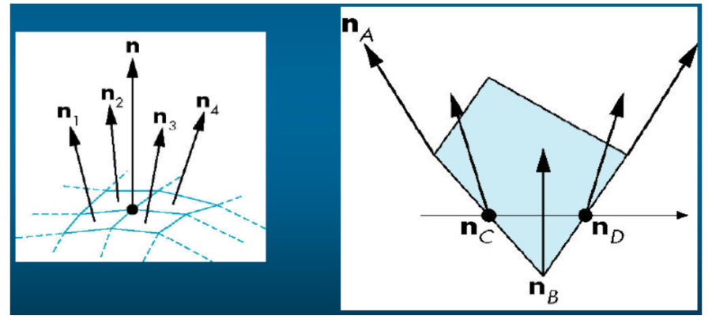
Shading
How to do Phong Shading

Slide 32
Shading
How to do Phong Shading

Slide 33
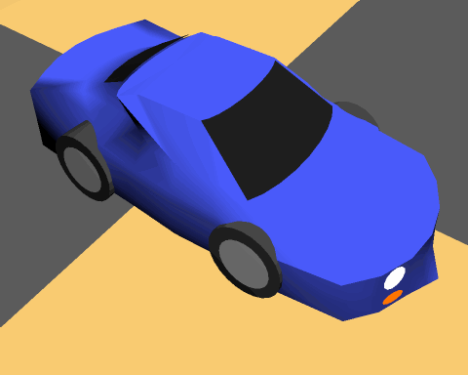
Shading
Example of Phong Shading

Slide 34
Shading
Phong Shading
Requires more computation than Gouraud shading…
But Advent of programmable GPUs now made this possible

Slide 35
Shading
Finally
Flat Shading
Compute Phong lighting once for entire polygon
Gouraud Shading
Compute Phong lighting at the vertices and interpolate lighting values across polygon
Phong Shading
Interpolate normals across polygon and perform Phong lighting across polygon

Slide 36
Lighting and Shading in OpenGL
Lighting in OpenGL
Enabling shading
glShadeModel(GL_FLAT)
glShadeModel(GL_SMOOTH); // Gouraud Shading only
Using light sources
Up to 8 light sources
To create a light
GLfloat light0_position[] = { 600, 40, 600, 1.0};
glLightfv(GL_LIGHT0, GL_POSITION, light0_position);
glEnable(GL_LIGHT0);
glEnable(GL_LIGHTING);

Slide 37
Lighting and Shading in OpenGL
Lighting in OpenGL
Changing light properties
GLfloat light0_ambient[] = { 0.4, 0.1, 0.0, 1.0 };
GLfloat light0_diffuse[] = { 0.9, 0.3, 0.3, 1.0 };
GLfloat light0_specular[] = { 0.0, 1.0, 1.0, 1.0 };
glLightfv(GL_LIGHT0, GL_AMBIENT, light0_ambient);
glLightfv(GL_LIGHT0, GL_DIFFUSE, light0_diffuse);
glLightfv(GL_LIGHT0, GL_SPECULAR, light0_specular);

Slide 38
Books
Foley, van Dam, Feiner, Hughes, Computer Graphics: principles and practice, Addison Wesley, Second Edition.
Schaum's Outline of Theory & Problems of Computer Graphics.
Peter Shirley Steve Marschner , “Fundamental of computer graphics”, Third Edition.
Schreiner et. al., OpenGL Programming Guide, Red Book

Slide 39
References
chapter 11: Schaum's Outline of Theory & Problems of Computer Graphics
Chapter 16: Foley, van Dam, Feiner, Hughes, Computer Graphics: principles and practice
Chapter 5: Schreiner et. al., OpenGL Programming Guide, Red Book
https://en.wikipedia.org/wiki/Computer_graphics_lighting

